Slide 1
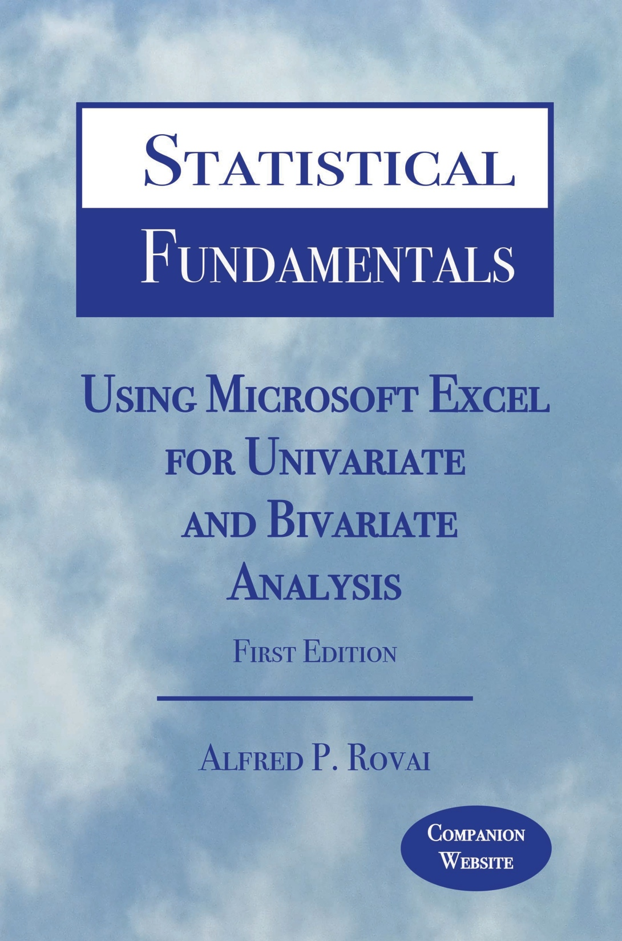
Statistical Fundamentals:
Using Microsoft Excel for Univariate and Bivariate Analysis
Alfred P. Rovai
Spearman Rank-Order Correlation Test
PowerPoint Prepared by
Alfred P. Rovai
Microsoft® Excel® Screen Prints Courtesy of Microsoft Corporation.

Slide 2
Spearman Rank-Order Correlation Test
The Spearman Rank Order Correlation Test (also known as Spearman rho) is a nonparametric symmetric procedure that determines the monotonic strength and direction of the relationship between two ranked variables.
Either the Greek letter ρ (rho) or r_{s} is used as the symbol for this correlation coefficient. It has a value in the range –1 ≤ r_{s} ≤ 1.
The absolute value of Spearman rho can be interpreted as follows:
  Little if any relationship < .30
  Low relationship = .30 to < .50
  Moderate relationship = .50 to < .70
  High relationship = .70 to < .90
  Very high relationship = .90 and above

Slide 3
Pearson Product-Moment Correlation
Excel data entry for this test is fairly straightforward. Each variable is entered in a sheet of the Excel workbook as a separate column.
Spearman rho is calculated as follows using raw scores.
where n is the number of pairs of ranks and d is the difference between the two ranks in each pair.
The following Excel function is used:
CORREL(array1,array2). Returns the correlation coefficient, where the two arrays identify the cell range of values for two variables

Slide 4
Spearman Rank-Order Correlation Test
The p-level for this correlation coefficient can be calculated using the t-distribution and the following t-value.
The degrees of freedom for this test is N− 2, where N is the number of cases in the analysis.
The following Excel function is used to determine the p-level:
T.DIST.2T(x,deg_freedom). Returns the t-distribution (2-tailed), where x is the numeric value at which to evaluate the distribution and deg_freedom is a number representing degrees of freedom.

Slide 5
Key Assumptions & Requirements
Random selection of samples to allow for generalization of results to a target population.
Variables. Two ranked variables (ordinal, interval, or ratio data can be used).
Absence of restricted range. Data range is not truncated for either variable.
Independence of observations.
Monotonicity. Monotonic relationship between variables, i.e., a monotonic relationship is one where the value of one variable increases as the value of the other variable increases or the value of one variable increases as the value of the other variable decreases, but not necessarily in a linear fashion.

Slide 6
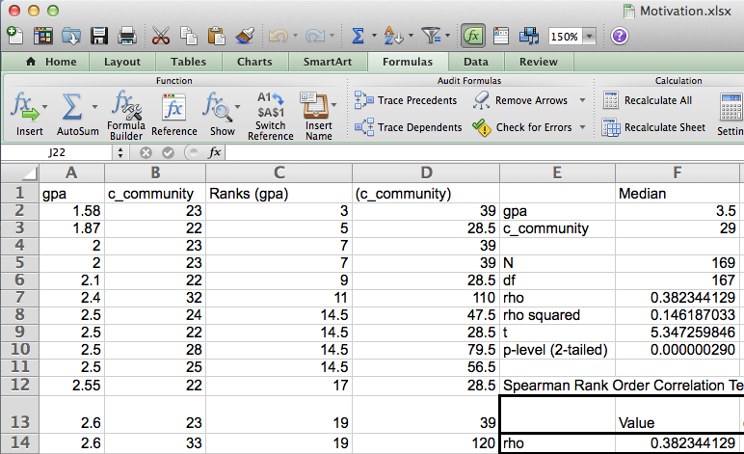
Open the dataset Motivation.xlsx. Click on the Spearman rho worksheet tab.
File available at http://www.watertreepress.com/stats
TASK
Respond to the following research question and null hypothesis:
Is there a relationship between grade point average and sense of classroom community?
H₀: There is no relationship between grade point average and sense of classroom community.

Slide 7
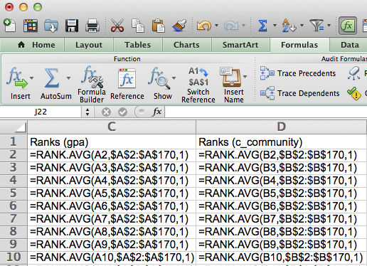
Enter labels and formulas in cells C1:D170 in order to generate ranks from raw scores for both variables (GPA and classroom community).

Slide 8
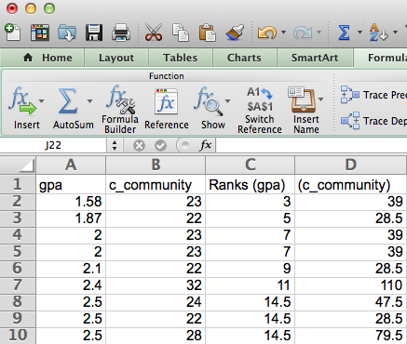

Slide 9
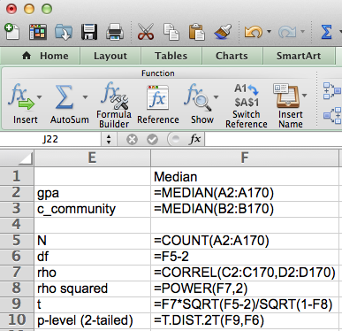
Enter the labels and formulas shown in cells E1:F10 in order to generate relevant statistics.

Slide 10
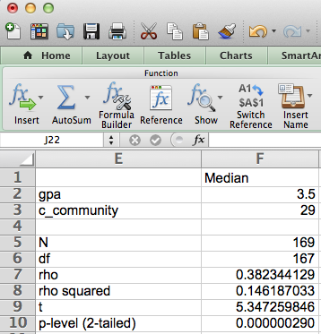
The results of the test provided evidence that grade point average (Mdn = 3.5) and sense of classroom community (Mdn = 29) are directly related, r_{s}(167) = .38, p <.001 (2-tailed). Therefore, there was sufficient evidence to reject the null hypothesis. The coefficient of determination was .15, indicating that both variables shared 15 percent of variance in common, which suggests a low but significant relationship.

Slide 11
Spearman Rank-Order Correlation Test
End of Presentation

